Slide 1
SUCCESSSFUL PRACTICES IN INDIGENOUS EDUCATION
FIRST NATIONS, METIS, AND INUIT EDUCATION
ANDREA FOX, DISTRICT PRINCIPAL
Lethbridge School District No.51

Slide 2
TRADITIONAL TERRITORIES
ACKNOWLEDGING THE TRADITIONAL TERRITORIES – respecting protocols to the First Peoples in the local regions that you are in (example: Blackfoot)
“We acknowledge that we are on the traditional territory of the Blackfoot First Nations Nitsitapi people.”

Slide 3
Who Am I?
Blackfoot Name is Bird Old Woman - Piiskipitaakii
Blackfoot, born in Lethbridge and raised in Kainai (Old Agency Community)
Youngest of 3, Parents married for 41 years - Mary and Gordon Fox
Aunty to Kiowa and Naela Thunder Chief
Graduated from Catholic Central High School
Graduated from University of Lethbridge – B.A., B.Ed.
Currently working on my M.Ed in Educational Leadership
Teacher in Holy Spirit Separate School District, Siksika Nation, Tsuu T’ina, Piikani, Kainai, Lethbridge School District
Taught Kindergarten – 12 and Guest Lecture at the U of L – Faculty of Education
Travel throughout Canada and the United States – presenting, sharing, performing
Cross Country Coach for the running club - Running Warriors in Kainai
I am most proud of being an aunty, a teacher, and taking my running club to McFarland, CA to run in the Half-Marathon and 5K in 2017

Slide 4
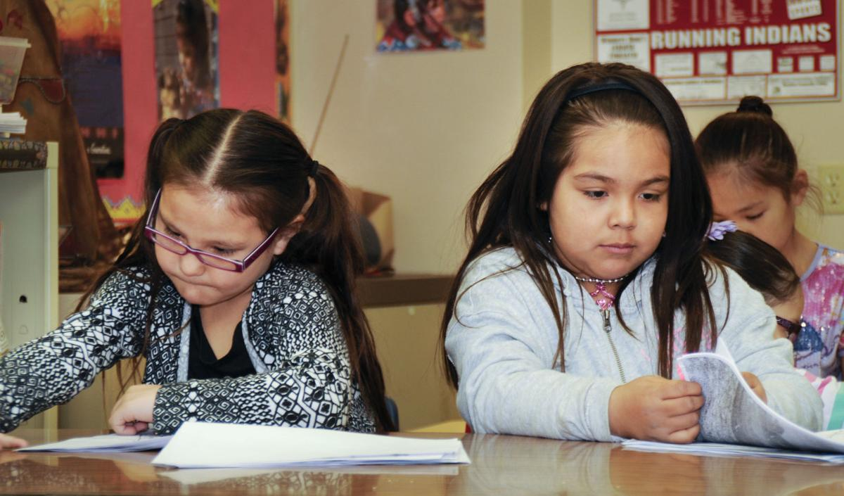
INQUIRY QUESTION…
In what ways and to what extent am I supporting Indigenous student learners?

Slide 5
Blackfoot Traditional Territory

Slide 6
Blackfoot land designations (also known as Reserves), have been minimized significantly after the Treaties were signed (as designated by the Government of Canada at the signing of Treaty 7, September 22, 1877)

Slide 7
The BLACKFOOT CONFEDERACY consists of 4 Tribes:
KAINAI – BLOOD TRIBE
PIIKANI – NORTH PEIGAN
SIKSIKA
BLACKFEET – SOUTHERN PEIGAN
(located in Northern Montana)

Slide 8
HISTORICAL IMPACTS OF COLONIZATION AFFECTING INDIGENOUS PEOPLE TODAY
Residential Schools
Family Connections are fragmented
Cultural Identity has been displaced
Intergenerational Trauma impacts ALL Indigenous people
Loss of Languages and Cultural Traditions
Sixty’s Scoop
Children in Foster Care
Loss of Connection to Family and Community
Question:
What are we doing to understand these issues as members of society and as educators?

Slide 9
Issues affecting and impacting many INDIGENOUS people in Canada / North America due to Colonization and Genocide in Canada
NO ACCESS TO CLEAN DRINKING WATER
SUICIDE RATES
MISSING AND MURDERED INDIGENOUS WOMEN
HIGH INCARCERATION RATES
UNEMPLOYMENT
CHILDREN TAKEN AWAY / APPREHENDED
STERILIZATION
RACISM
STEREOTYPES
RESIDENTIAL SCHOOL

Slide 10
Revising Teaching Practices in Canada with Respect to Indigenous Youth and History
https://www.youtube.com/watch?v=xhEh-D7IRQc
https://www.youtube.com/watch?v=fbQGhP4xQkw

Slide 11
FOSTERING EFFECITVE RELATIONSHIPS WITH INDIGENOUS STUDENTS AND COMMUNITIES…
STUDENTS
FAMILIES – PARENTS, GRANDPARENTS, GUARDIANS
COMMUNITY
ELDERS
CULTURAL CONSULTANTS
SCHOOL COMMUNITY AND INDIGENOUS COMMUNITY CONNECTIONS
ATTENDING CULTURAL EVENTS

Slide 12
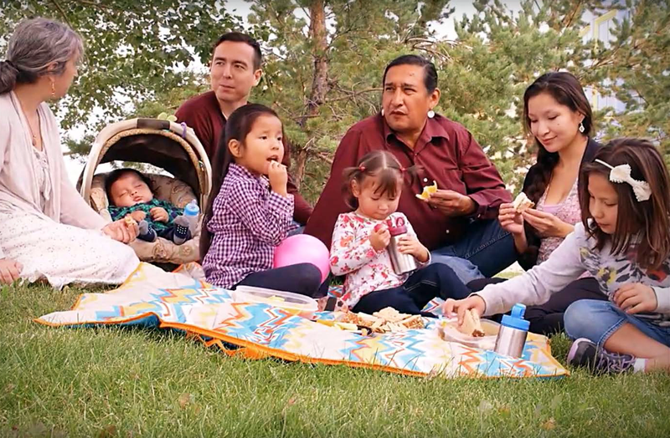
WELCOMING OUR INDIGENOUS FAMILIES INTO OUR SCHOOLS
WHAT DOES THIS LOOK LIKE?
HOW ARE WE WELCOMING OUR INDIGENOUS FAMLIIES INTO OUR CLASSROOMS/SCHOOLS?
HOW ARE WE ENSURING OUR INDIGENOUS FAMLIES & STUDENTS FEEL WELCOMED IN OUR SCHOOLS?
HOW DO WE WORK WITH THE PARENTS OF OUR INDIGENOUS STUDENTS? RESOLVE ISSUES/CONCERNS THEY EXPRESS?
LISTEN, LISTEN, LISTEN…… THIS WILL HELP THE PROCESS OF GETTING TO KNOW OUR INDIGENOUS FAMLIIES AND STUDENTS….

Slide 13
BEST PRACTICES TO SUPPORT INDIGENOUS STUDENT LEARNERS
ACCESS AND APPLY AUTHENIC AND APPROPRIATE RESOURCES:
PEOPLE, COMMUNITY CONNECTIONS, LITERATURE, PROFESSIONAL LEARNING
KEEP YOUR KNOWLEDGE UPDATED, CURRENT AND STAY INFORMED
ASK YOURSELF WHEN USING RESOURCES: IS IT CULTURALLY APPROPRIATE and is it AUTHENTIC? IF YOU DON’T KNOW-THEN ASK ☺
CONSULT WITH THE FNMI LIAISON, DISTRICT PRINCIPAL, COMMUNITY, FAMILIES, ELDERS, EDUCATORS
CHECK YOUR ASSUMPTIONS
Key Questions:
How will all of students perceive these resources?
How will this impact Indigenous student learners?
How can I connect with Indigenous student learners in an authentic way?

Slide 14
TRUTH AND RECONCILIATION
We have only started with Truth in respect to Truth and Reconciliation.
Truth and Reconciliation must first start with “TRUTH”.
All members of society have a role and responsibility in Truth and Reconciliation.
It’s okay to be uncomfortable.
Educators have a special place in Truth and Reconciliation
Truth and Reconciliation Report – 94 Calls to Action (7 for Education)
https://www.aadnc-aandc.gc.ca/eng/1524495412051/1524495479084
"Reconciliation is about forging and maintaining respectful relationships. There are no shortcuts." -Justice Murray Sinclair
http://www.trc.ca/websites/trcinstitution/index.php?p=3

Slide 15
OUR CELEBRATIONS….
INDIGENOUS YOUTH SUCCESS – ADVOCATING, GETTING INVOLVED, LEADERSHIP
LANGUAGE & CULTURAL REVITALIZATIONS
POST-SECONDARY GRADUATION RATES-INCREASING
MANY SUCCESSFUL ROLES IN THE WORK FORCE:
LAWYERS, DOCTORS, TEACHERS, SOCIAL WORKERS, POLICE, PROFESSORS, WRITERS, ARTISTS, ENTREPRENEURS, SCIENTISTS, NURSES, JUDGES, MPs, CONSULTANTS, ELECTRICIANS, PRINCIPALS….etc.

Slide 16
“Children succeed when they feel connected to their culture, when they learn their languages, when they feel safe and accepted, and when they believe in themselves!” – Andrea Fox, District Principal of FNMI Education
“Our children succeed when they feel connected to their culture, when they learn their languages, when they feel safe and accepted, when they believe in themselves!”
– Andrea Fox

Slide 17
WHERE DO WE GO FROM HERE?
Check in with yourself to remain informed:
IS IT CULTURALLY APPROPRIATE?
IS IT CONNECTED TO COMMUNITY?
HOW ARE YOU GETTING INVOLVED WITH THE INDIGENOUS COMMUNITY?
REMEMBER TO ALWAYS KEEP AN OPEN MIND.
Question the sources that deliver information about Indigenous people (ex: media, political groups, etc.)
Contact Andrea:
andrea.fox@lethsd.ab.ca
403-394-4442
@a_truejoy_fox

Slide 18
“Today's daily advocacy tip! Don’t rely on just one day of action to accomplish your goal. You need 365+ days of action so think about multiple peaceful strategies to accomplish the goal.” – Dr. Cindy Blackstock
Twitter: @cblackst

Slide 19
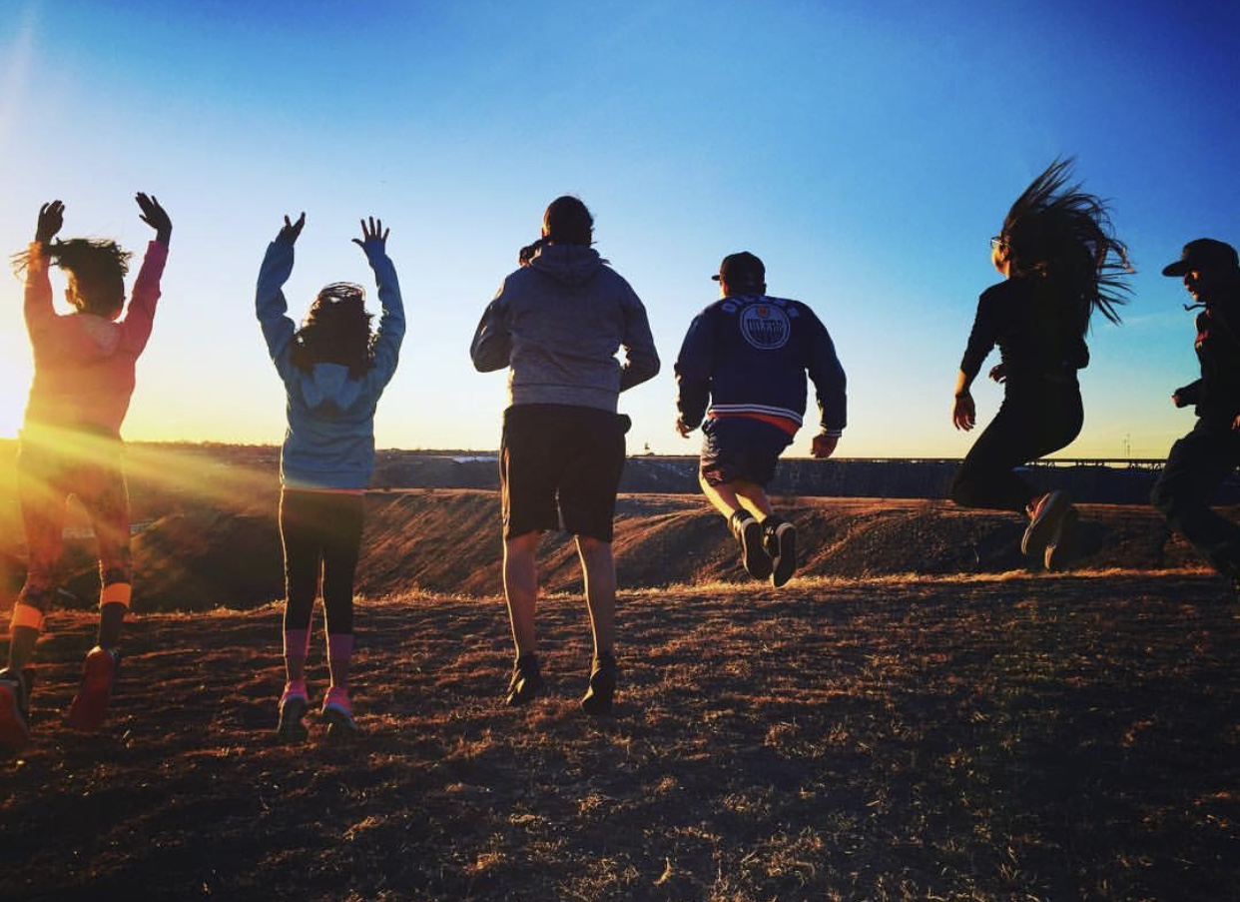
THE FUTURE IS NOW
Together WE can….

