Slide 1
Powwow dances

Slide 2
What is a powwow?
A powwow is an expression of First Nations identity, it is also a statement of our ability to survive as a people.
Men, women and children who participate in powwows have regalia according to the category they participate in.
Anyone can attend a powwow, everyone is welcome!

Slide 3
Mens grass dance
Long ago, the dancers wore outfits that were made solely with the materials that were naturally available such as grass, porcupine quills and hair
The outfits of grass dancers today consist of a belt, cuffs, headband and harness with a porcupine roach which adorns two eagle feathers or a set of plumes.
Each outfit is designed to move with and enhance the motions of the dancer. The dancer moves his hips, arms, head and shoulders in harmony with the movement of his legs and dance steps. Dancers attempt to imitate nature, resembling the gentle swaying of grass on a windy day. Grass dancers must display balance, endurance, coordination and gracefulness. All movements are done both on the left and right sides.
It is said that in the early days of pow wow that the grass dancers role in the pow wow circle was to flatten the long high grass in the dance area before the rest of the dancers participated.
https://www.youtube.com/watch?v=jPz0dt4xkFs

Slide 4
Mens traditional
Traditional style of dance is one of pride and confidence amongst First Nations men.
The dance depicts the telling of a war story or hunting expedition.
The outfit consists of beaded vests, war shields and porcupine roaches. A single, circular bustle made of eagle feathers is worn on the back. Most dancers carry some sort of staff or dancing stick.
While the dancers are dancing, they appear to be strong, bold warriors. They tell a complete story that can be seen in their dance steps as they bend low to the ground and peer cautiously about. The process is repeated as an on-going hunt. The completion of the successful hunt is demonstrated as they move in for the kill.
Traditional dancers never dance backwards as they perform, as this would be perceived as retreat.
https://www.youtube.com/watch?v=MEnYkp0bCIg

Slide 5
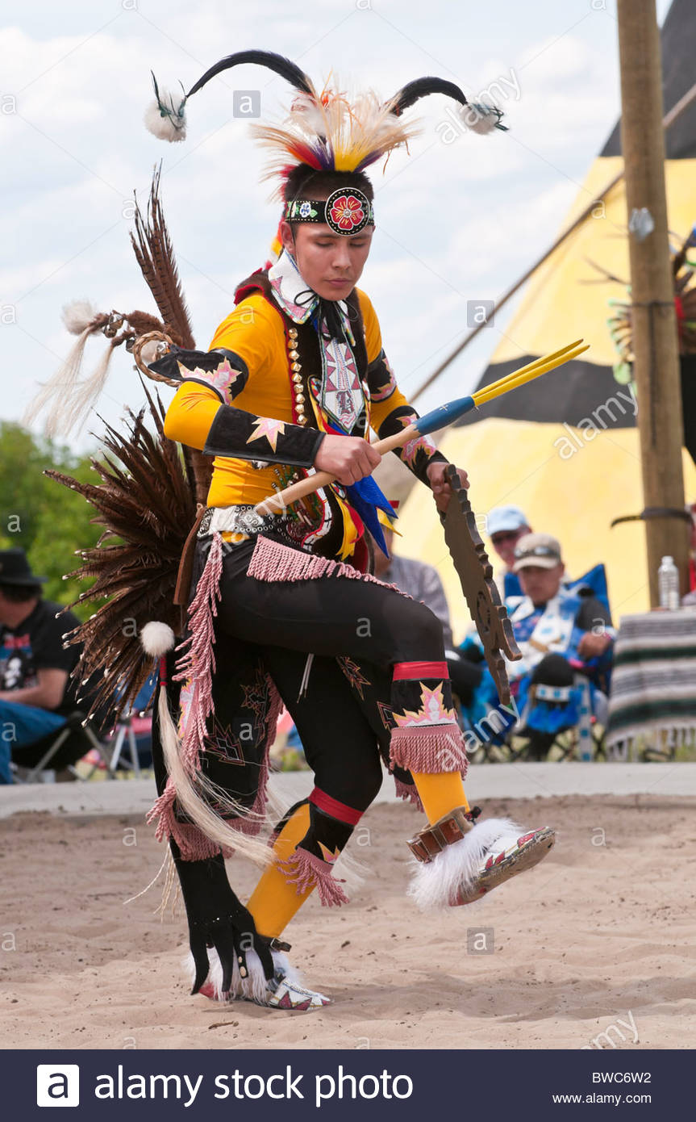
Mens chicken dance
Originated in the Blackfoot territory, which we currently reside on. It is one of the oldest forms of dancing.
A story told about the Chicken Dance is, long ago there was a young man hunting for his family. He heard a noise in the distance and got very curious so he followed the sound. As he approached the sound he saw these prairie chickens dancing in the tall grass. He took his bow and arrow and shot one of the birds. After the man's family was done eating their dinner, they went to lay their heads down for the night. When this man was sleeping he had a dream that this prairie chicken spirit came to him and asked him "Why did you kill me? were doing a sacred dance of my people". The man replied and said that he needed to feed his family. The prairie chicken had honored this and so he told this man that he was going to teach him the sacred dance of his people and that he must go out and teach it to others.
https://www.youtube.com/watch?v=gi71kz-3I9o

Slide 6
Mens fancy dance
The origination of this dance came from the Southern tribes in Oklahoma, USA and was for the purpose of entertainment.
The bright colours of the outfits and the fast moves of the dancers provide an entertaining sight for onlookers. Men's Fancy dancers wear two brightly coloured bustles on their backs. Some dancers choose to make their bustles out of man-made feathers while others choose eagle feathers.
The Men's Fancy Dance is, in many respects, a test of a dancer's endurance. A dancer must be physically fit and well-coordinated because the dance requires a great deal of muscle control. It also permits the dancers to display highly complex dance steps and body movements.
https://www.youtube.com/watch?v=Y8eHtV7_COo

Slide 7
Womens jingle dress dance
Is a healing dance of the Ojibwe people.
A story behind the origin of the Jingle Dress…a man’s daughter was very ill so he sought a vision, in that vision he saw a dress with hundreds of shells/tin cones on it. He was told his daughter must dance in this dress and she will begin to heal. The man made a dress for his daughter just like the one in his vision and asked her to dance in it. At first she couldn’t and needed assistance but soon after she was able to get the strength to dance on her own.
The jingles are placed close enough so they can hit together, causing a beautiful sound. If one were to close their eyes as the Jingle dancer passes, it would sound as though it were raining.
https://www.youtube.com/watch?v=iArcG-S3_QM

Slide 8
Womens traditional dance
Women’s traditional is a very dignified, graceful and modest dance that shows the strength, pride, respect and honour the women carry for their family, relatives and friends.
Regalia consists of a buckskin dress decorated with beads/shells.
Women usually carry a fan made of eagle feathers. On the down beats or honour beats of the song, the women may raise their fan gracefully to show respect and honour as they dance
https://www.youtube.com/watch?v=lRiKl3__-98

Slide 9
Womens fancy shawl dance
This dance symbolizes the life of a butterfly; displaying beauty and grace.
It is in the movement of her body while she dances and the lightness of her dance steps that makes the butterfly come to life. A fancy shawl dancer dances to a fast drum beat as do the men's fancy dancers. A dancer shows gracefulness, endurance and agility as she moves in perfect beat with the drum. While she dances, her shawl sways and swirls in perfect harmony with her body; a butterfly flitting ever so delicately about the dance arena.
https://www.youtube.com/watch?v=5StSRU9Oc2w

Slide 10
Hoop Dance
it is a storytelling dance.
The dancer uses many colorful hoops and his or her own body to create intricate shapes, often telling the story of life
Some of the shapes you may notice in the hoop dance are what looks like an eagle, a butterfly, the world… keep an eye out for what you can see!
https://www.youtube.com/watch?v=K3HglDDwfow

Slide 11
Round dance
The round dance is a friendship dance.
It has an infectious upbeat tempo.
Individuals stand in a circle and take each others hand, then side step clockwise to the beat of the drum.
A dance in which spectators are invited to participate, along with an intertribal dance.
https://www.youtube.com/watch?v=bwDYCAOXcQQ

